Slide 1
Preliminary Design Review
“CHILLY”
Commanded Harvesting of Ice Lunar Lander Yield
MCA Team 09
Team Members:
Omor Almamun, Michael Alvarez, Samuel Brauer, Nathan Etheridge, Sonali Garg, Arely Herrera, Kanishka Kamal, Mackenzie Lloyd, Hiromi Nurse, Thanh Pham, Andrew Tran, Troy Tran

Slide 2
Agenda
1
4
2
5
3
6
Mission Overview
Engineering Subsystems
Programmatics
Science
Engineering
Conclusion

Slide 3
Mission Overview
The goal of this mission is to study the composition of water-ice and other volatiles during phase changes within the permanently shadowed regions (PSRs) of the Leibnitz Beta Plateau on the moon. This is being done to measure the viability of long-term settlements on the moon that would use these resources to survive.
What are our science goals?
Goal 2a refers to determining water ice abundance in lunar regolith
Goal 6n concerns the change in hydrogen, oxygen, and other sedimentary particles within the water ice during phase changes
How will we accomplish these?
Using CHILLY lunar rover
Instruments?
Ground Penetrating Radar (GPR)
Near Infrared Volatile Spectrometer Subsystem (NIRVSS)

Slide 4
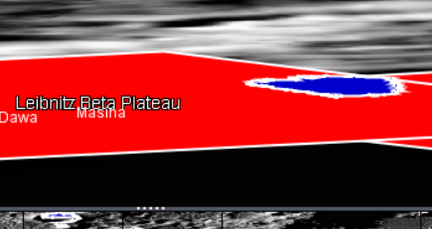
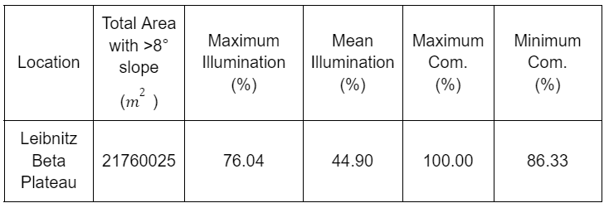
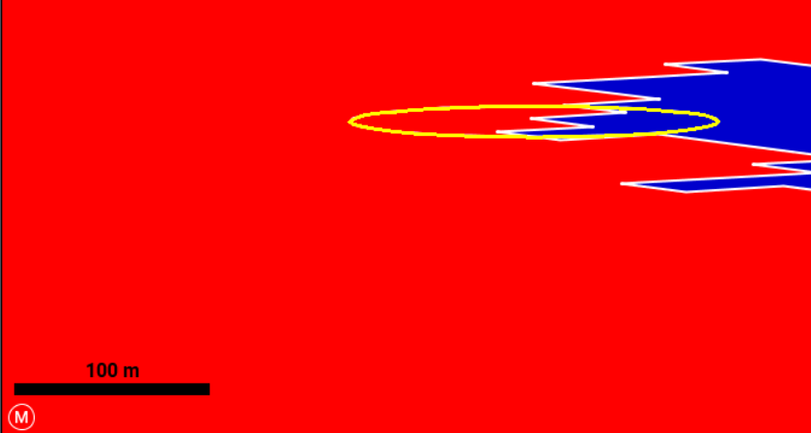
Mission Location
Artemis III Landing Site: Leibnitz Beta Plateau
PSR rich area with 78% of PSR being favorable to water ice
Minimal elevation changes
Good illumination and communications conditions
Notes:
Landing radius centered at -85.203°N, 33.258°E
Blue area is PSR, landing site has both
Slope less than 8 degree change so good for rover

Slide 5

Major Driving Requirements/Constraints
Req # | Requirement |  | Rationale
MR-1 | The vehicle shall be ready for launch from Cape Canaveral by September 1st, 2028. |  | Since the vehicle is a secondary payload, it must be ready for launch when the primary payload launches.
MR-2 | The system shall operate within a 10 km radius from the landing location in Leibnitz Beta Plateau. |  | The site the vehicle is investigating cannot exceed a distance of 10 km from the landing site as specified in the mission task document.
MR-3 | The system shall have a mission lifespan of 20 weeks. |  | The minimum amount of time to acquire sufficient data to satisfy the science objectives.
MR-4 | The system shall have a total mass less than 85 kg. |  | The mass of the system cannot exceed a mass of 85 kg due to being a secondary payload as specified by the customer in the mission task document.
MR-5 | The system shall have a total volume less than a Length 1.5m x Width 1.5m x Height 1.5m for the stored configuration prior to deployment. |  | The volume of the system cannot exceed the allowed volume due to being a secondary payload as specified by the customer in the mission task document.
MR-6 | The mission shall have a cost less than $225M. |  | The mission may not exceed the allowed budget specified by the customer in the mission task document.
SYS-1 | Any radioactive material used by the system shall have a cumulative mass less than 5g. |  | The system can not use more than 5g of radioactive material in total as specified by the customer in the mission task document.
Notes:
Our major requirements and constraints are listed below in this simplified requirements table. Some of the major driving requirements and constraints include a volume constraint of 1.5m in length, width, and height and a mass constraint of 85 kg. Both of these requirements have been met. Additionally, the limit of two scientific instruments has been met. As well as, the limit of radioactive material. The budget and schedule requirements have also been met and will be further discussed in the programmatics section.

Slide 6
Programmatics

Slide 7
Mission Schedule
Phase C: Final Design and Fabrication
Begins after completion of PDR and involves the finalization of construction/software development of all subsystems and the writing of the CDR.
Phase D: Test Launch
This phase is designed to simulate launch day to analyze how the mission vehicle handles the launch and weather conditions of Cape Canaveral and validate its final launch.
Phase E: Operations and Sustainment
This phase includes monitoring the mission vehicle while it is performing its mission task on the surface of the moon while ensuring proper operation.
Jul 2026
Sep 2028
Jan 2029
Aug 2024
Apr 2027
Sep 2028
Phase D: System Assembly, Integration and Test
This phase is designed to test the mission vehicle against the simulated harsh conditions of the lunar landing sight with each subsystem having specialized testing environments at the Ames Research Center.
Phase D: Launch
This phase includes the final launch of the vehicle from Cape Canaveral on September 1, 2028, and the analysis of the mission as it departs to the Moon after launch.
Phase F: Closeout
This phase includes the return and retrieval of data from the mission for the team to analyze and draw conclusions from and create a final mission report.
Notes:
Phase C: Each subsystem is allocated an approximately 70-day period in the time from phase C to phase D for tasks pertaining to construction to be completed
Phase D: Decision to use the Ames Research Center in Mountain View, CA due to its specialized facilities such as wind tunnels and turbulent flow facilities

Slide 8
Major Tasks
Phase C
Phase D
Finalization/Approval of Vehicle Design
Construction of Subsystems
Conducting/Presenting CDR
Conduct Environmental Testing
Calibrate Science Instrumentation
Test Launch
Phase E
Phase F
Monitoring Landing/ Vehicle Stability
Confirm Landing Site Conditions
Conduct water-ice experiments on lunar surface
Prepare Vehicle for Return Journey
Analyze Mission Data
Prepare/Present Mission Report

Slide 9
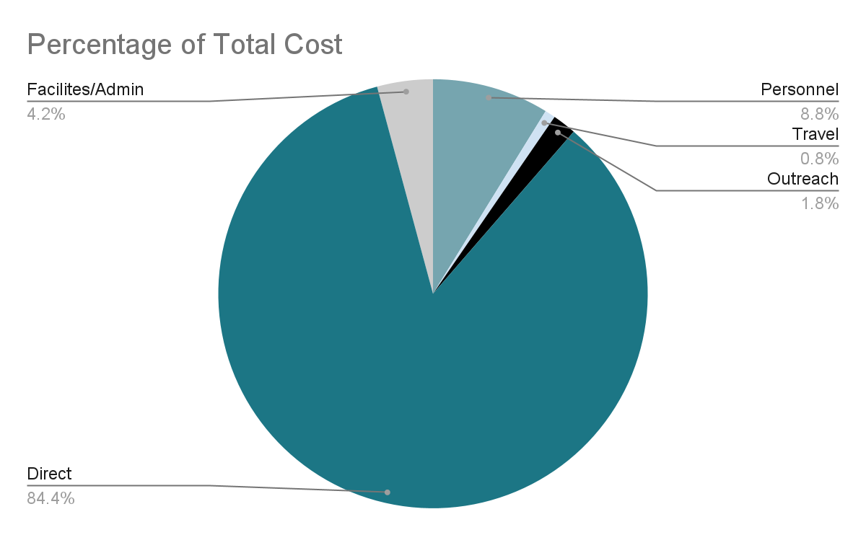
Mission Budget
Expense Category | Cost (USD)
Direct | $146,675,213
Facilities/Admin | $7,292,619
Outreach | $3,109,350
Personnel | $15,272,146
Travel | $1,378,129
Total Cost: $173,727,456

Slide 10
Category Breakdown
Direct Costs
Facilities/Admin
Travel
Encompasses the majority of the project’s budget and consist of the costs of all the mission vehicle subsystems and all testing and manufacturing facilities costs associated with them including:
Manufacturing Costs
Test Facility Costs
Facility Costs
Science Instrumentation
Subsystem Costs
Includes the costs paid directly to the facility housing development excluding the cost of the facility directly. (i.e. office supplies, equipment)
Outlines the personnel travel for the various reasons throughout the mission duration based on per diem rates for required destinations.
Personnel
Outreach
Includes the salaries and benefits of the 26-31 science, engineering, technician, administration, and management personnel found on the mission team.
Funding for the outreach operations of the mission to communities. Intended to educate all ages on mission and STEM education.

Slide 11
Subsystem Cost Breakdown
Subsystem | Phase C | Phase C-D | Phase D | Phase E-F | Phase F | Total
Mechanical Subsystem | $ 5,016,000 | $ 1,482,000 | $ 1,482,000 | $ 620,000 | $ 330,000 | $ 8,930,000
Power Subsystem | $ 13,200,200 | $ 3,390,000 | $ 1,150,000 | $ 1,800,000 | $ 1,480,000 | $ 21,020,200
Thermal Control Subsystem | $ 1,900,000 | $ 200,000 | $ 200,000 | $ 260,000 | $ 80,000 | $ 2,640,000
Comms & Data Handling Subsystem | $ 7,700,000 | $ 2,300,000 | $ 2,300,000 | $ 1,060,000 | $ 290,000 | $ 13,650,000
Guidance, Nav, & Control Subsystem | $ 600,000 | $ 114,000 | $ 114,000 | $ 160,000 | $ 20,000 | $ 1,008,000
Science Instrumentation | $ 15,400,000 | $ 2,840,000 | $ 2,840,000 | $ 800,000 | $ 740,000 | $ 22,620,000

Slide 12
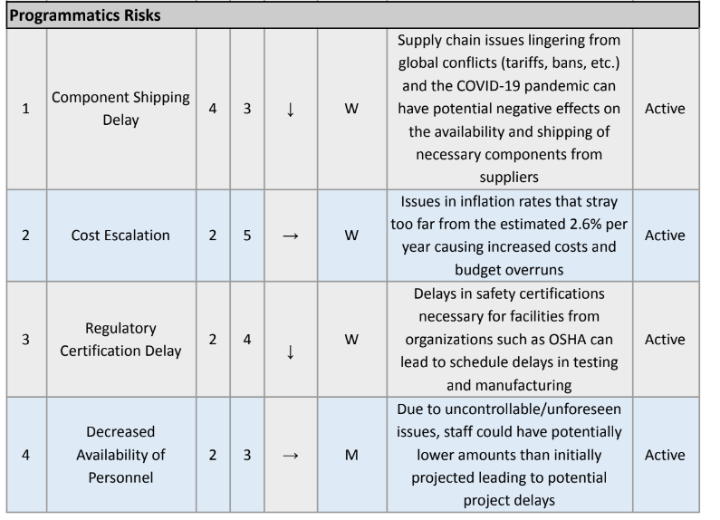
Programmatics Risks

Slide 13

Engineering
Notes:
Howdy, my name is Mackenzie and I am the lead systems engineer.

Slide 14
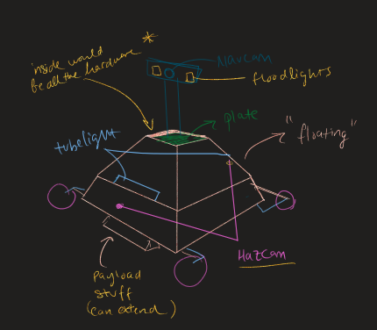

Vehicle Design Summary
Rover
Subsystems:
Mechanical
Power
Command and Data Handling (CDH)
Thermal
Payload
Preliminary illustration of the CHILLY rover
Notes:
In order to satisfy the science goals chosen for the CHILLY mission, a rover design has been selected. The rover will have five different subsystems. The mechanical subsystem provides the structure, suspension, locomotion, GNC, and sample collection subassemblies. The power subsystem is in charge of power generation, storage, and distribution. The CDH subsystem handles the rover commands, communications, and storage and transmitting of the science and health data. The thermal subsystem regulates the temperatures of all components on the rover, ensuring everything remains within its required operation temperatures. Finally, the payload subsystem hosts the two science instruments selected to collect the necessary scientific data. And shown to the right, is a preliminary sketch of the CHILLY rover.

Slide 15

CHILLY’s Mass, Volume, Max Power Draw and TRL
Mass, Volume, and Max Power Draw Table
Technology Readiness Level (TRL) Table
Subassembly | Mass (kg) | Volume (m³) | Max Power Draw (W)
Mechanical | 38.572 | 4.0836 × 10⁻² | 763
Power | 26 | 0.23 | 320
CDH | ? | ? | ?
Thermal | ~16 | ~0.0458 | ?
Payload | 7.6 | 0.0125 | 40
Total | ? | ? | ?
Subsystem | TRL
Mechanical | 5
Power | 6
CDH | 5
Thermal | 5
Payload | 7
Total | 5
Notes:
Outlined below is the CHILLY rover’s Mass, Volume, and Max Power Draw Table. Unfortunately, the mass, volume, and max power draw for the CDH and thermal subsystem are unavailable at this time. The technology readiness levels for each subsystem and the rover as a whole are outlined in the TRL table. The total TRL for the system is at a 5, but will increase with additional testing.

Slide 16
Engineering Subsystems

Slide 17

Mechanical Subsystem

Slide 18

Main Requirements
The mechanical subsystem shall withstand takeoff and landing conditions.
The rover shall be capable of traversing a maximum slope of 15 degrees.
The system shall be capable of deploying mechanisms for power consumption and scientific data collection.
The system shall support the payload in data and sample collection.
The mechanical system shall be able to withstand a temperature range of -233°C to 123°C.
The mechanical system shall be able to navigate in the Leibnitz Beta Plateau.

Slide 19
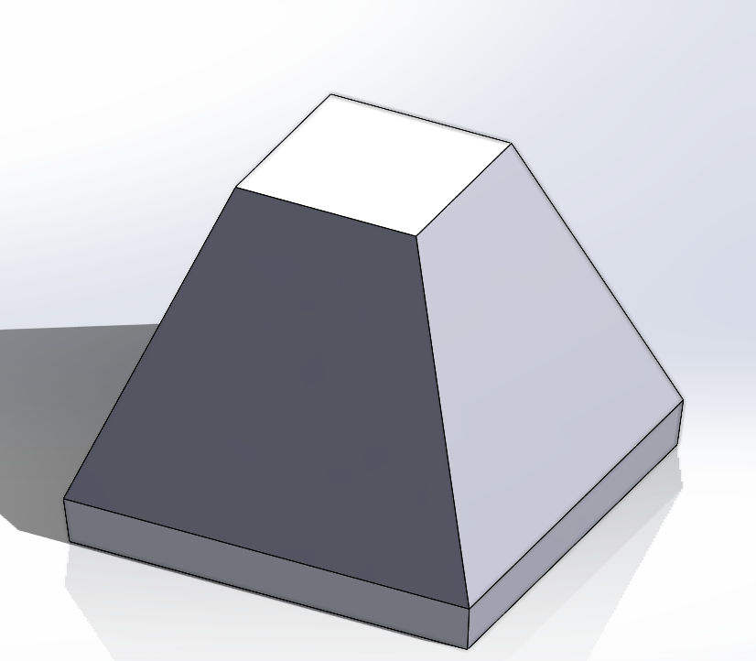
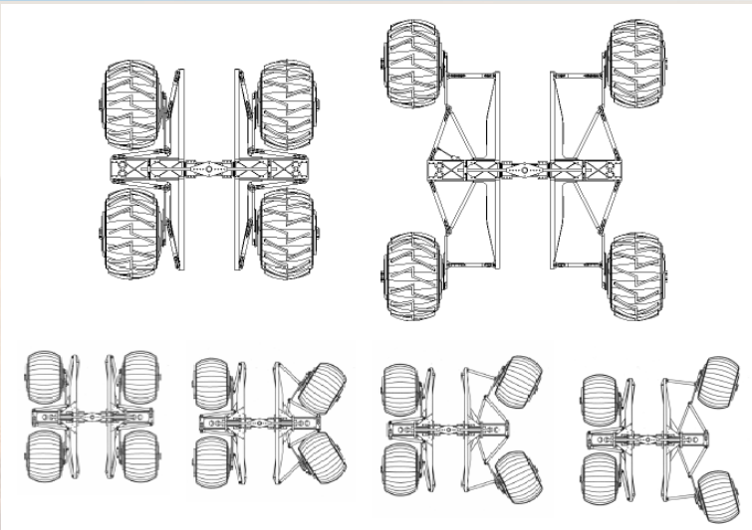
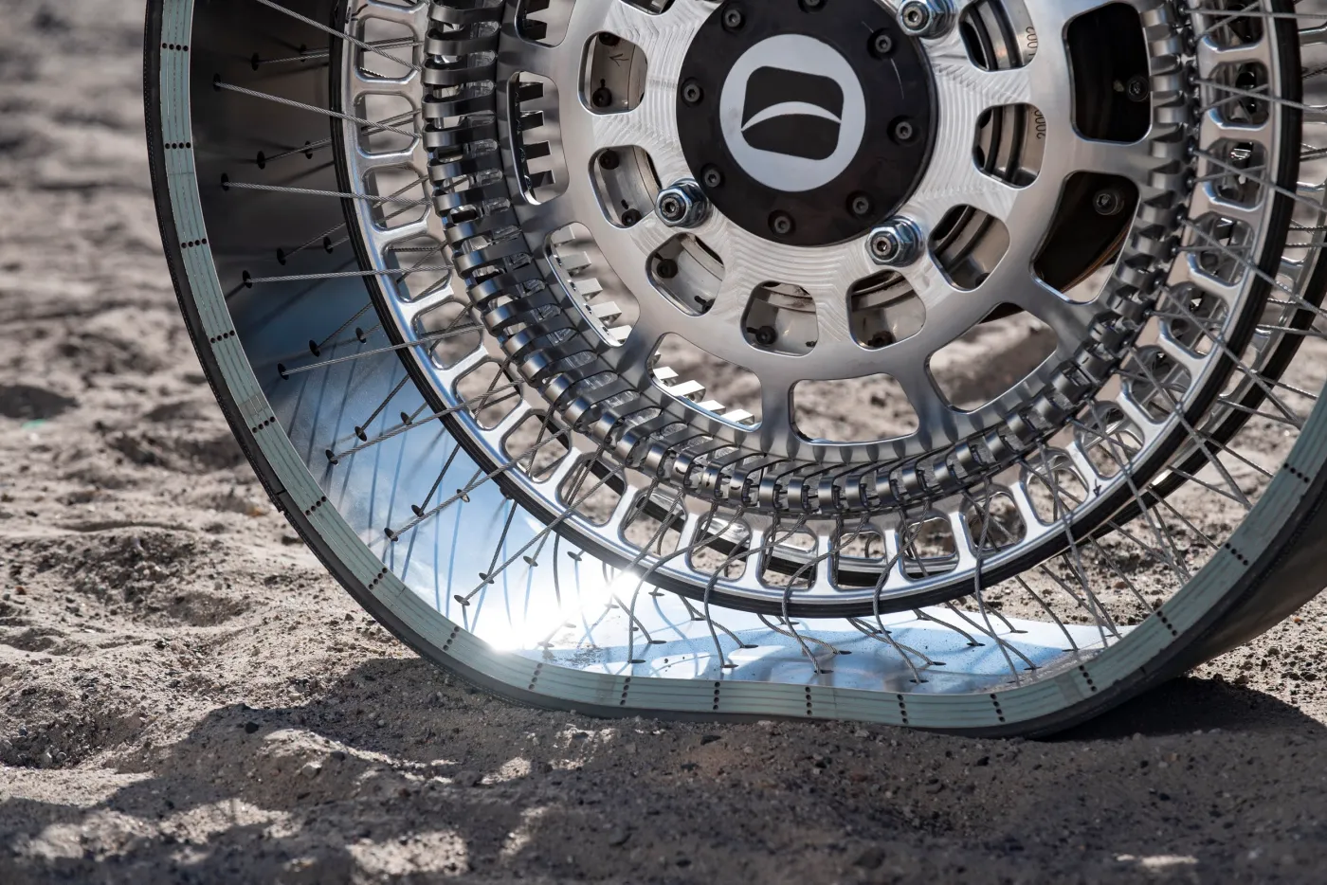
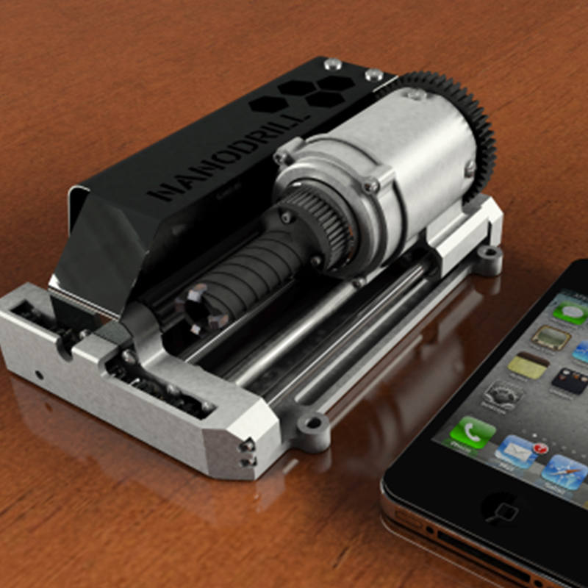
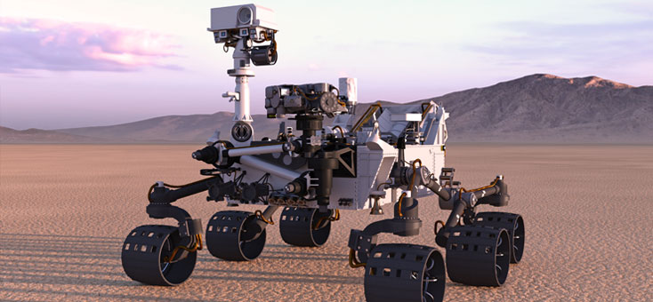

Subassemblies
Structural
Suspension
Locomotion
GNC
Sample Collection

Slide 20

Mechanical Risks & Mitigations
Risk | Mitigation Strategy
Lunar Dust & Regolith Damage | Body to secure the internal components Frame and chassis hybrid design Deformable wheels
Vibrational Shocks | Expanded state of rover Springs & dampers
Unexpected Stand Still | In-wheel motors Expansion state Cameras & hazard lights
Extreme Temperature Range Damage | NASA tested gearbox All components are surveyed and tested for moon’s surface conditions

Slide 21

Summary
TRL 5
Subassembly | Mass | Volume | Max Power Draw
Structures | 15 kg | 2.9 x 10⁻³ m³ | 0 W
Suspension | 7 kg | 8.4 × 10⁻³ m³ | 0 W
Locomotion | 5.772 kg | 2.03376 × 10⁻² m³ | 600 W
GNC | 6.7 kg | 5.8 × 10⁻³ m³ | 83 W
Sample Collection | 4.1 kg | 3.4 × 10⁻³ m³ | 80 W
Total | 38.572 kg | 4.0836 × 10⁻² m³ | 763 W

Slide 22
Power Subsystem

Slide 23
Main Requirements
The power subsystem shall provide continuous power to all rover subsystems throughout the mission.
The power subsystem shall have a minimum power generation capacity of 200 watts.
The batteries shall have a specific energy around 200 Wh/kg.
The power subsystem shall have a total mass not exceeding 30 kg.
The system shall operate in temperatures ranging from -233°C to 123°C.
The health monitoring system shall have a data transmission capability to Earth.

Slide 24
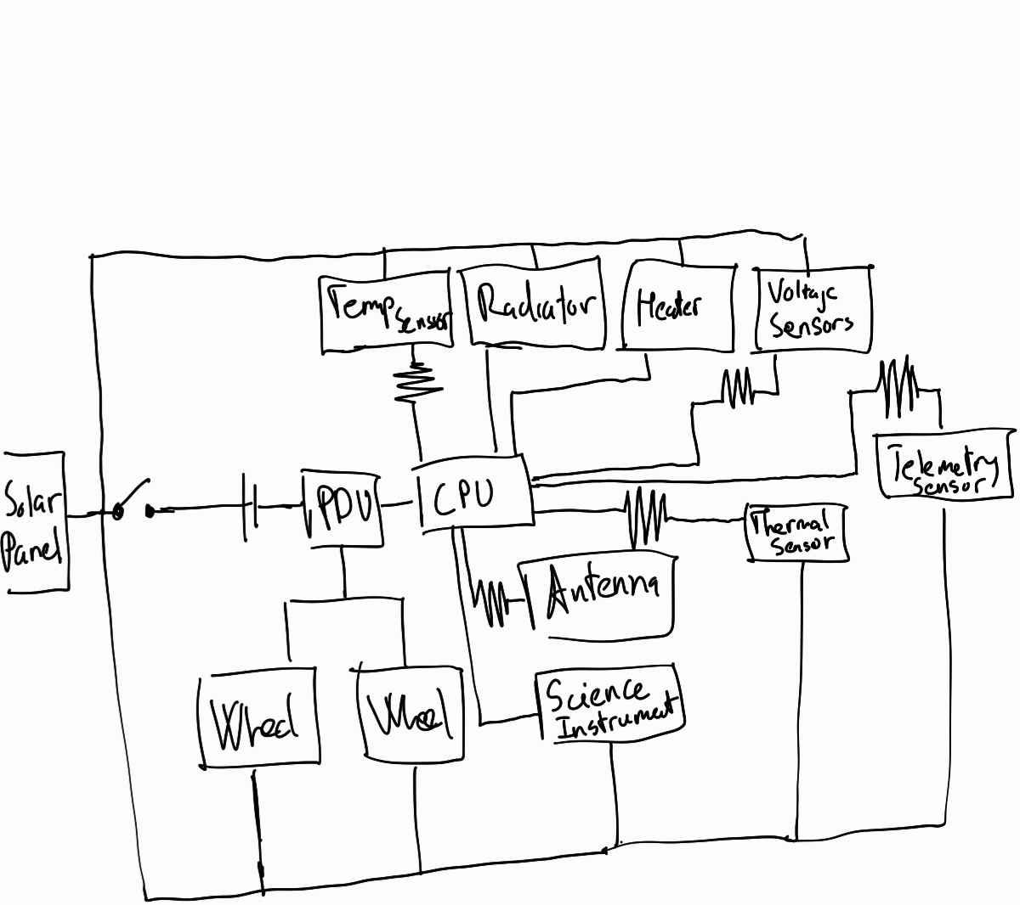
Subassemblies
Solar Cell Panels
Battery Packs System
Power Distribution Unit
Thermal Management System
Health Monitoring System

Slide 25
Risk Assessment
ID | Summary | L | C | Trend | Approach | Risk Statement | Status
1 | Power Generation Failure | 3 | 5 | ↓ | M | Build up lunar dust | Active
2 | Battery Malfunction | 2 | 4 | ↓ | M | Temperature fluctuation | Active
3 | Inadequate Power Resource | 4 | 4 | → | R | Long period without sunlgiht | Active
Notes:
Dust or damage to the primary power source may cause power failure in the rover's mission. The solar cells instead of solar panels are used to mitigate large damage and must be built in high quality to reduce lunar dust.
Dust Resistant Coating Seal enclosure internal components Extreme temperature fluctuations can degrade batteries' performance. A thermal system management has been added specifically for the power system in order to maintain an ideal temperature. Polypropylene film: thermal insulation Phase change material
Solar cells may experience long shadow periods that do not provide energy. Batteries are the recovery option, but they will not last long for an endurance mission. program the firmware

Slide 26
Summary
Subassembly | Mass | Volume | Max Power Draw
Solar Cell Panels (85 cells) | 0.426 kg | 7.084 x 10⁻⁵ m³ | 0W
Batteries | 17.397 kg | 1.646 x 10⁻² m³ | 0W
PDU | 2.3 kg | 1.178 x 10⁻⁴ m³ | 5W
Thermal Management System | 1 kg | 9.58812 x 10⁻³ m³ | 0W
Health Monitoring System | 1.3 kg | 9.5273 x 10⁻⁴ m³ | 8.5W
Total | 22.423 kg | 2.718949 x 10⁻² m³ | 13.5 W

Slide 27
CDH Subsystem

Slide 28
Main Requirements
The subsystem shall communicate with the primary mission orbiter for the duration of the mission lifetime
CDH system uses Ultra High Frequency (UHF) for communication between rover and orbiter for a bandwidth of a few kilobits per second and S band and X band for a bandwidth of up to tens of mbps.
CDH operations scheduled around temperatures ranging from -250°C to +120°C.
CDH System employs error detection and correction through voting logic to withstand up to 7 single event upsets per second.
CDH transmits and stores in a data format standardized by the Consultative Committee for Space Data Systems (CCSDS), which includes deployment of the Space Packet Protocol (SPP) and
binary data.

Slide 29
Subassemblies
HGA (High gain antenna) used for communication with Earth
LGA (Low gain antenna) provides wide angle coverage
Space grade radiation hardened RAD750 CPU
Leonardo DRS is the choice for SSD and RAM because of their advanced electronic
systems.
VxWorks operating system

Slide 30
Thermal Subsystem

Slide 31
Main Requirements
The system shall operate in temperatures ranging from -233°C to 123°C.
The thermal control system shall be capable of withstanding thermal cycles experienced between sunlit and shaded regions as well as day/night cycles, including PSRs.
The thermal control system shall keep other subsystems and instruments within the required operating range of -40°C to 40°C.
The thermal control system shall use 10-15% of the total rover's power.
The thermal control system shall have a mass less than 20 kg.
The system shall maintain an internal temperature of -40 to 40 degrees Celcius for the duration of the mission.
The thermal control system shall include passive thermal insulation to minimize heat loss and gain.
The thermal control system shall monitor and report the temperature in real-time.

Slide 32
Subassemblies
Multi-Layer Aerogel Composite
Water PCM + Container
Louvers
Temperature Sensor
Thermostat
Heat Pipes
Radiators
Heater

Slide 33
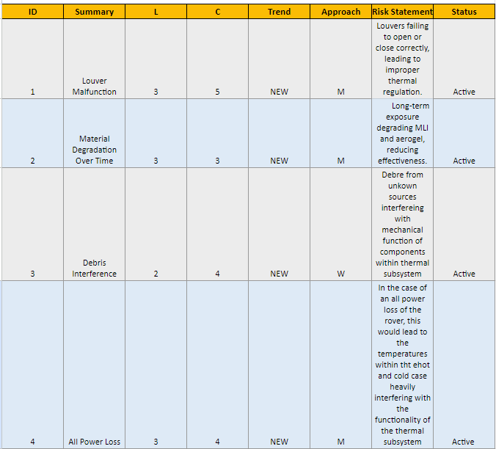
Thermal Risks

Slide 34
Summary (TRL 5)
Subassembly | Mass | Volume | Max Power Draw
Multi-Layer Aerogel Composite | 0.01045451326 m^3 x 15 kg/m^3 = ~0.157 kg | 2.7511877 m^2 x 3.8 mm thickness = ~0.01045451326 m^3 | 0 W
PCM+Container | 1.585 + 0.308 = 1.893 kg | .0.001728 m^3 | 0 W
Radiators | 3 kg | 0.0036 m^3 | 0 W
Louvers | ~10 kg | 1.06658 m^2 | 0 W
Heat Pipes | 500.66 g | 0.00031556 m^3 | 0 W
Heater(s) | ~500 g | 0.0001 m^3 | 40 W
Thermostat(s) | ~20 g | 0.00001 m^3 | 0.1 W
Temperature sensor(s) | ~20 g | 0.000005 m^3 | 0.1 W
Total | ~ 16 kg | ~0.0458 m^3 | ~41 W

Slide 35
Science

Slide 36
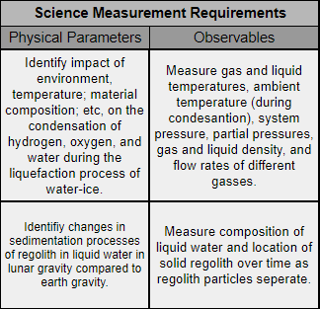
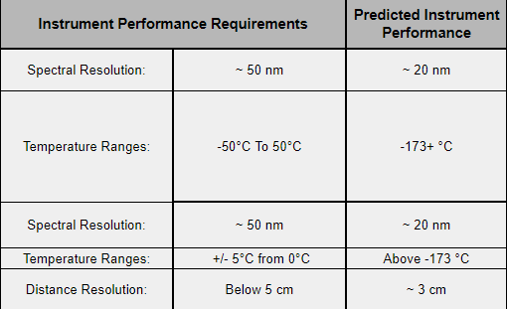
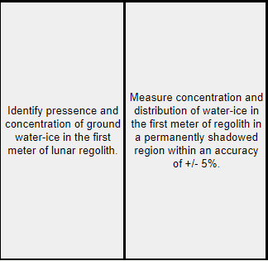
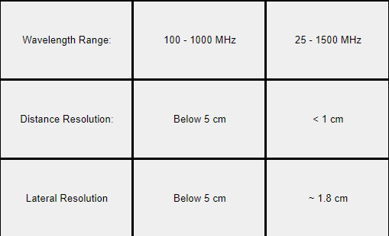
Science Traceability Matrix
Notes:
The STM contains a lot of specific information regarding the measurements to be made by the science instruments.
This includes the science goals, their associated science objectives, the physical parameters of those objectives, the observables related to those physical parameters, the instrument performance requirements, the instrument predicted performance, the instruments, as well as the mission requirement.
For the Chilly mission, the physical parameters and instrumental performance dealt with spatial resolution, temperature, and spectral resolution.
For science goal 6n, the spectra need to be measured within 50 nm, temperature between -50 and +50 C, and spatial distance equal or less than 5 cm. All of these requirements are met with the instruments chosen.
For science goal 2a, varying wavelengths of produced em radiation between 100 and 1000 MHz need to be produced and distance and lateral resolutions equal to or less than 5 cm. With the GPR this should be achievable within the mission lifespan.
The GRP has a high technology readiness level (TRL) as it has not only been used on lunar rovers in the past but has also been studied extensively. The large amount of studies and demonstrations of its function allow for it to have a high TRL, only requiring limited testing in the Chilly rover.
The NIRVSS has a high TRL rating as it has been used on previous missions and is currently employed on a mission. Examples such as the VIPER mission, which has an objective similar to CHILLY and uses the NIRVSS to examine volatiles on the moon, demonstrate the high TRL given to the NIRVSS.

Slide 37
Science Instrumentation
Strata Ground-Penetrating Radar
Near-Infrared Volatiles Spectrometer System
The GPR uses electromagnetic radiation traveling through and bouncing off of materials underground to make a model of the strata beneath the instrument.
It can also be used to provide supplementary data of particulates in suspension of a liquid.
This will allow the mission to complete science objective 2a as well as assist with some portions of 6n.
The NIRVSS uses several instruments to make differing measurements. This includes thermopiles to take temperature, spectrometers to measure spectra, and an optical camera with varying lighting implements.
These will allow the mission to complete science objective 6n with more precision than the GPR would provide.
Notes:
The Chilly mission employs two science instruments, the GRP and the NIRVS system. The GRP will focus on measuring the water-ice abundance while the NIRVSS will be mainly used to complete the remaining objectives regarding condensation and sedimentation processes.
The GPR uses two antenna to produce and measure the attenuation of reflected waves. This provides enough data to determine the contents of the regolith as well as position of said contents without needing to drill into the ground.
The NIRVSS is a set of multiple instruments including spectrometers of differing wavelengths, optical camera, and thermopiles. This will allow the measurement of temperature data, spectral measurements, as well as visual pictures of samples or the psr.

Slide 38
Payload Subsystem
Notes:
I will be introducing the payload subsystem for science instrumentation

Slide 39
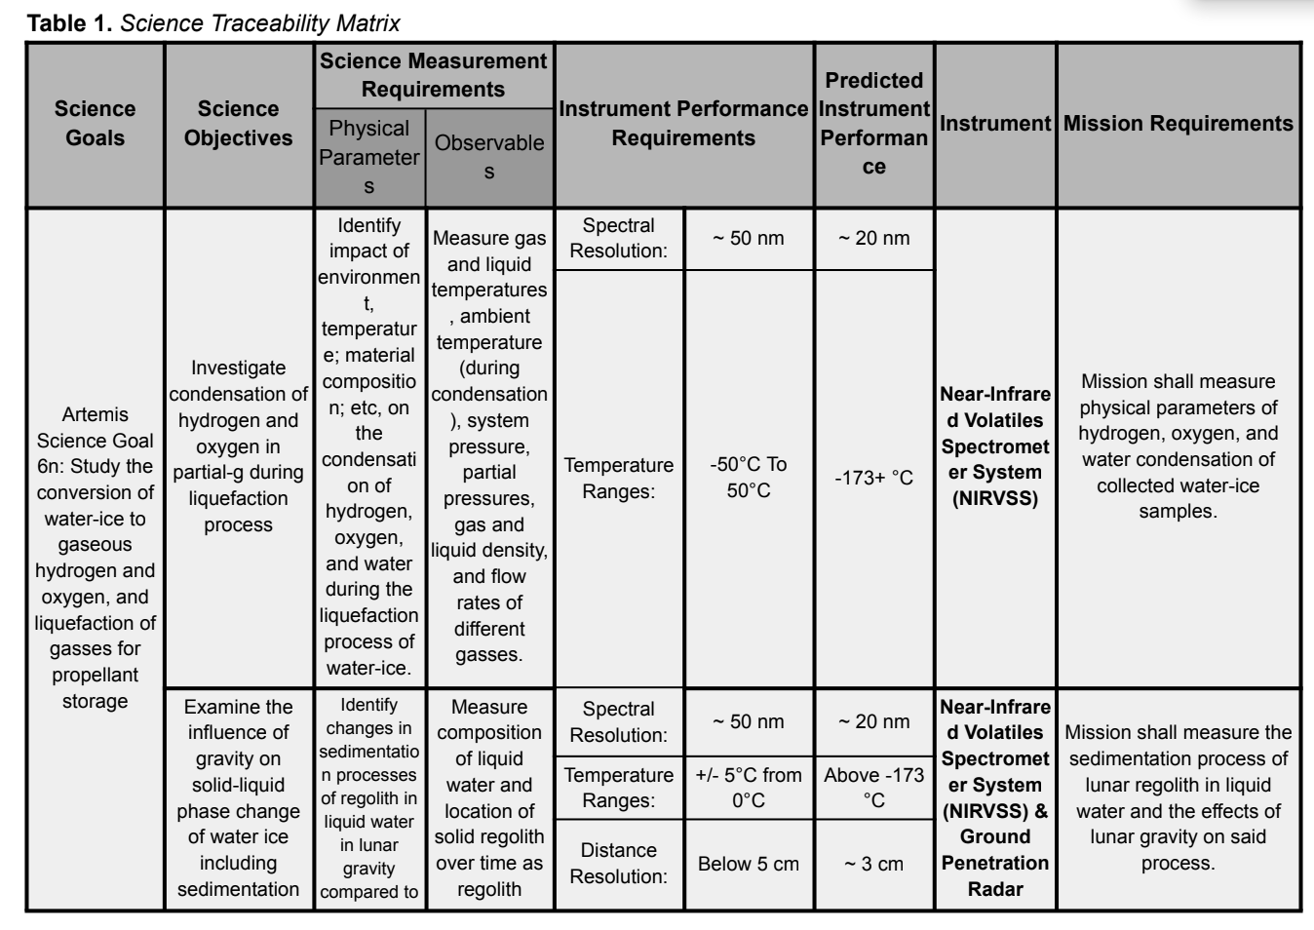
Recovery/Redundancy Plans
No backup science instruments due to cost and space constraints
Mission goals may not be achieved if instrument fails or may lead to limited scientific data
Mitigations
Instrument criteria overlap
Notes:
Although we're unable to include backup science instruments due to cost and space constraints, the instruments were selected with significant overlap in capabilities. This means that even if one instrument fails, the other instruments can still complete the mission objectives to a certain capability, ensuring that our science goals are met as fully as possible. For instance, on the science traceability matrix shown on the right we can see that spectral resolution, temperature, and distance resolution can be met by both instruments to meet the science objective of solid-liquid phase change of water-ice on the lunar surface.

Slide 40
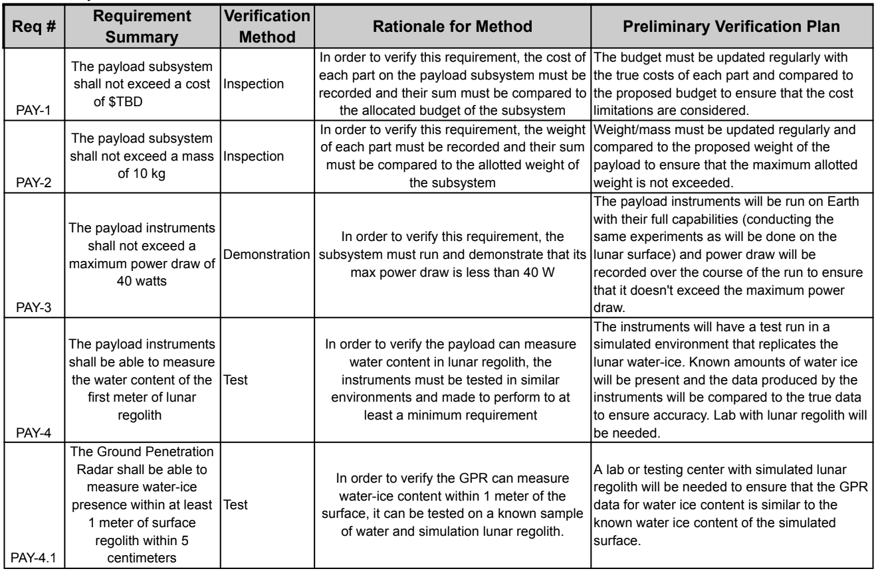
Instrumentation Manufacturing and Verification Methods
Strata Ground-Penetrating Radar (GPR)
Primary supplier: Astrobotic Technology Inc
Lead time: 12 to 30 months
Near-Infrared Volatiles Spectrometer System (NIRVSS)
Primary supplier: ThermoFisher Scientific
Lead time: >12 months
Notes:
The GPR instrumentation will be supplied by Astrobotic Technology, chosen for their strong track record with NASA and their experience in developing GPR technology for lunar missions. The estimated lead time for GPR development ranges from 12 to 30 months, as the technology is still advancing. //As a backup, Geophysical Survey Systems could be considered, but their systems would require additional adaptation for lunar use, extending the lead time to over 30 months.//
NIRVSS will use suppliers from NASA's previous Resource Prospector Mission to ensure consistency and reliability. This supplier is ThermoFisher Scientific, which is known for its high-quality optical instruments and strong relationship with NASA, and will provide the spectrometer optical engines. The estimated lead time for ThermoFisher's NIR Process Analyzer ranges from 16 to 24 weeks, and the complete flight-ready NIRVSS system is expected to require over 12 months for production.
Additionally, there are several verification methods set in place for each instrumentation to determine if all mission requirements are met. The verifications methods include demonstrations, testing, and inspections.

Slide 41
Science Mission Plan

Slide 42
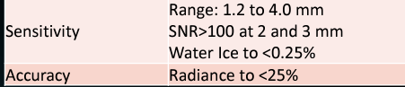
Testing/Calibration and Precision/Accuracy
Testing and Calibration
GPR: equipment antenna frequency and orientation will be altered depending on depth and resolution needed; noise will be removed post-data collection
NIRVSS: photometric linearity test and thermal sensibility test to determine accurate temperatures and spectral measurements
Precision and Accuracy:
GPR: average precision rate of 84% and accuracy of 60%-70%
NIRVSS:
Notes:
During data collection, variables such as antenna orientation, survey speed, and regular calibration must be managed to ensure consistent data quality
Linearity: accuracy test for spectrometers, thermal sensibility: temp
Gpr: simulated images and field images have been used to determine the precision of GPRs, which is calculated by dividing the number of correctly detected rebars by all detected rebars
Nirvss: different spectral resolutions, one from 10-20 nm and the other from 20-40 nm

Slide 43
Experimental Logic, Approach and Method of Investigation
Ground Penetrating Radar
Transmit high frequency radio waves
Receiver antenna catches radio waves
Onboard computer processes the data and produces 3D map of lunar regolith
NIRVSS
Infrared lamp illuminates sample location site
Longwave calibration sensor measures temperature measurement at given location
Robotic arm will deliver sample to NIRVSS
Spectrometer box and CMOS sensor work together to discern wavelengths
Notes:
transmitter antenna will be expected to produce between 25 and 1500 MHz radio waves to take measurements below the surface
a ratio of ground water-ice to regolith within the top meter of lunar regolith can be collected
Fulfills 2a (abundance) and 6n
Bracket 1: lamp, CMOS sensor, calibration temp sensor
Bracket 2: Spectrometer box
Fulfills 6n

Slide 44
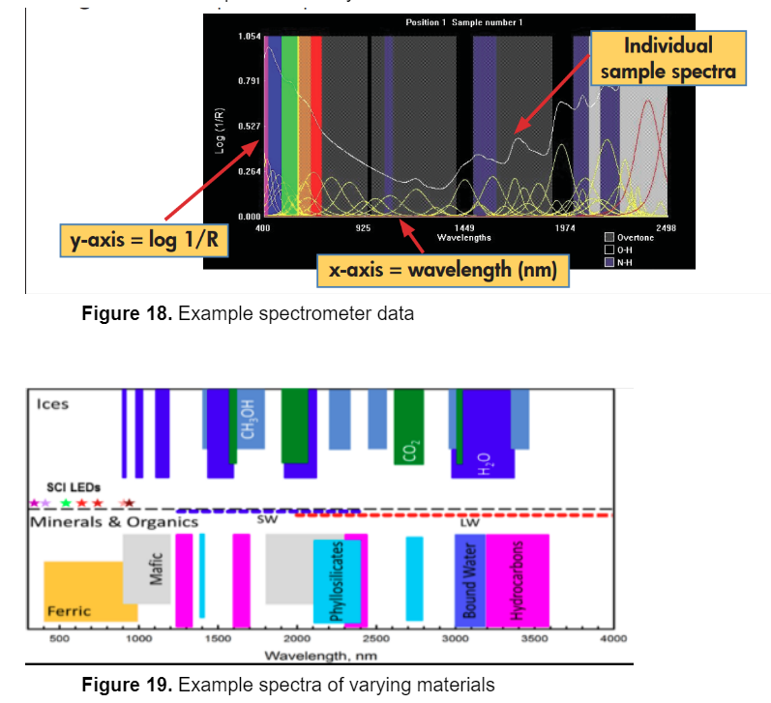
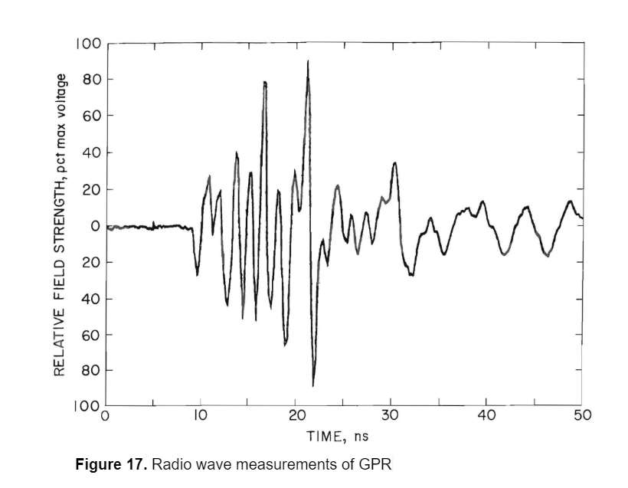
Expected Data and Analysis
NIRVSS
Ground Penetrating Radar
Notes:
different materials in the path of the radio can be obtained using the max voltage measured at that time.
Using the speed of the rover and its position, the location of the underground deposits of water or other volatiles can be measured
spectral readings, the material being focused on can be determined by comparing to the known spectra of materials. This, combined with temperature readings and visual pictures will allow the Chilly mission to determine the nature of sedimentation in the lunar PSR’s
surface composition as well as the sedimentation patterns of water-ice

Slide 45
Payload Risks
 | LIKELIHOOD | 5
 |  | 4 |  |  | 1
 |  | 3 |  |  | 2 | 5
 |  | 2 |  |  |  | 3, 4
 |  | 1
 |  |  | 1 | 2 | 3 | 4 | 5
 |  |  | CONSEQUENCES
Payload Risks
1 | Payload: GPR & NIRVSS | 4 | 3 | New | M | Lunar dust reduces signal accuracy | Active
2 | Payload: GPR | 3 | 3 | New | A | Excess sedimentary particles cluttering image | Active
3 | Payload: NIRVSS | 2 | 4 | New | W | Temperature fluctuations affecting capabilities | Active
4 | Planetary Protection | 2 | 4 | New | M | Contaminating lunar regolith with Earth's organic materials | Active
5 | Payload: GPR & NIRVSS | 3 | 4 | New | W | Wear on wheel treads due to abrasive lunar regolith reduces mobility | Active

Slide 46
Overview/Conclusion
Extensive research has been conducted to this point
Many rounds of risk analysis has been performed
Were ready for the next steps that being CDR
Ready to start manufacturing parts for CHILLY
CHILLY is on its way to Launch!!!

